Slide 1
Обзор популярных библиотек для IOS - Едем на правильных велосипедах.
Михаил Меркулов

Slide 2



AGENDA
Networking
UI
Data
Various

Slide 3
Networking
ASIHTTPRequest
AFNetworking
SDURLCache
RESTKit

Slide 4
ASIHTTPRequest
http://allseeing-i.com/ASIHTTPRequest/
Popular, but not supported
Features:
Download data to memory or directly to a file on disk
Progress delegates (+ progress indicators for operation queues)
Authentication support (Basic, NTML, Digest) + keychain support
Requests can continue to run when your app moves to the background
Cache support
Amazon S3
Manual and auto-detected proxies, authenticating proxies
Bandwidth throttling support
Supports synchronous & asynchronous requests (delegation & blocks)

Slide 5
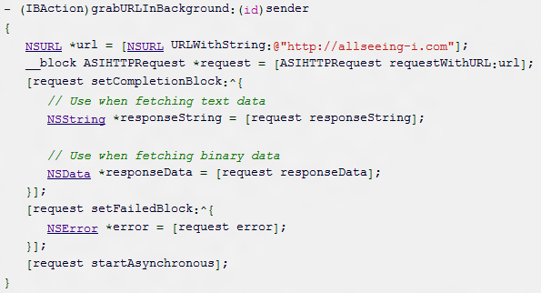
ASIHTTPRequest
Creating an asynchronous request

Slide 6
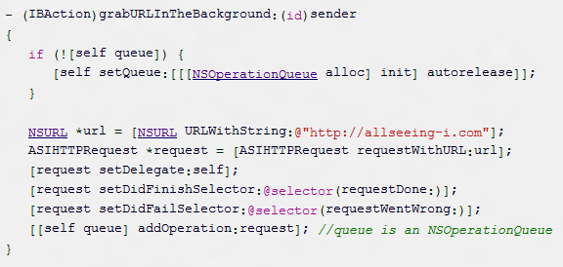

ASIHTTPRequest
Using a queue
Sending data

Slide 7


ASIHTTPRequest
Downloading data
Tracking download progress for a single request
Using a download cache

Slide 8
AFNetworking
https://github.com/AFNetworking/AFNetworking/
http://afnetworking.org/Documentation
Requires iOS 4.0+
Features:
JSON (NSJSONSerialization, JSONKit…), XML, Property List support
UIImageView+AFNetworking
Stream uploads and downloads, handle authentication, monitor upload and download progress
Extensions (OAuth, Amazon S3, KissXML, HTTP logger, JSON-RPC, TouchXML, GDataXML, RSS Parser)

Slide 9
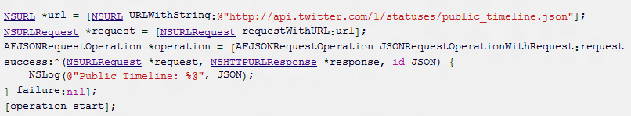
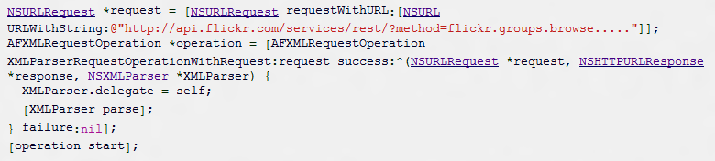
AFNetworking
Asynchronous request
Xml request

Slide 10
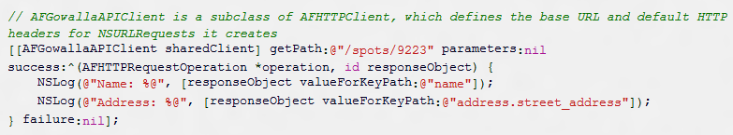

AFNetworking
API Client Request
Image Request

Slide 11
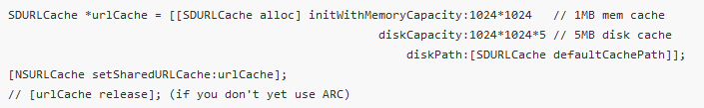
SDURLCache
https://github.com/steipete/SDURLCache, fork of https://github.com/rs/SDURLCache
NSURLCache with disk support

Slide 12
Restkit
https://github.com/RestKit/RestKit
RestKit is a framework for consuming and modeling RESTful web resources on iOS and OS X
Three main compoments:
Network (Async, SSL, Auth)
Object Mapping (JSON/XML, KVC)
Core Data (Active Record pattern)

Slide 13
UI
CorePlot
AQGridView
three20
ViewDeck
TTTAttributedLabel
MTStatusBarOverlay
MBProgressHUD
Reader

Slide 14
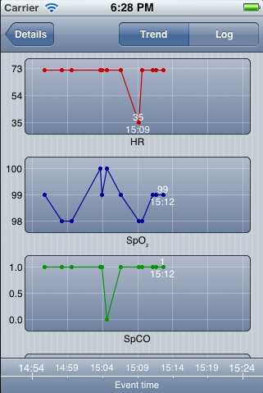
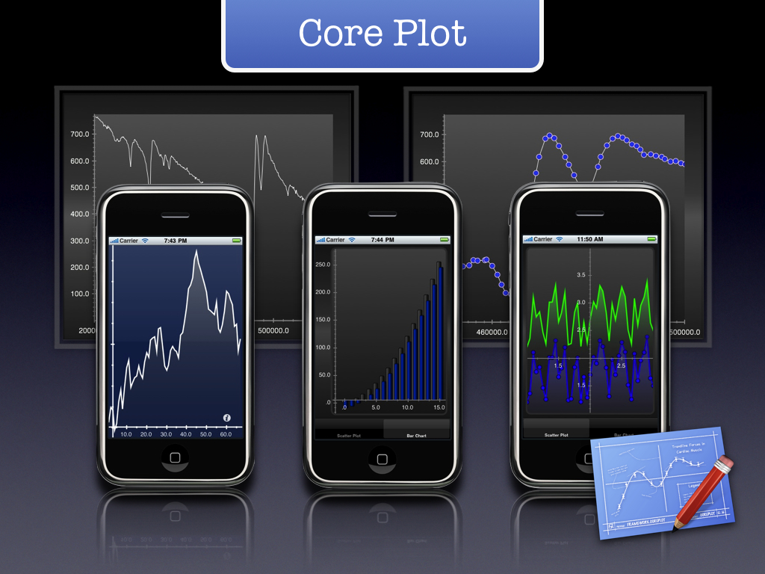
CorePlot
http://code.google.com/p/core-plot/
Provides 2D visualization of data, and is tightly integrated with Apple technologies like Core Animation, Core Data, and Cocoa Bindings.

Slide 15
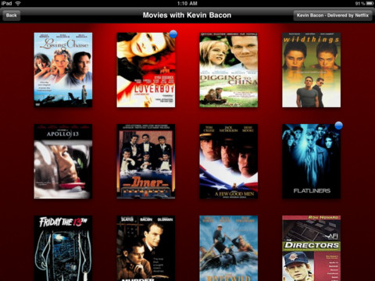
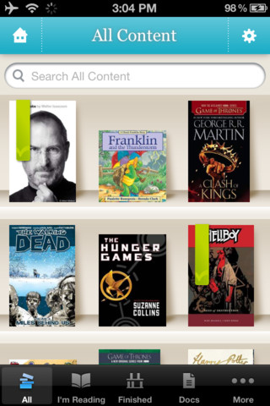
AQGridView
https://github.com/AlanQuatermain/AQGridView/

Slide 16
AQGridView
Similarities with UITableView
A subclass of UIScrollView.
Reusable grid cells, similar to UITableViewCell.
Data source and delegate very similar to those used with UITableView.
Immediate and batched changes to the content list (insert, remove, reorder, reload).
Similar change animations (top, bottom, left, right, fade).
Support for custom header and footer views.
Differences from UITableView
No sections— uses NSUInteger as its index location rather than NSIndexPath.
The delegate gets an opportunity to adjust the layout frame for each cell as it is displayed.
The grid layout is adjusted to fit the contentSize width.
A customizable ‘glow’ selection style

Slide 17
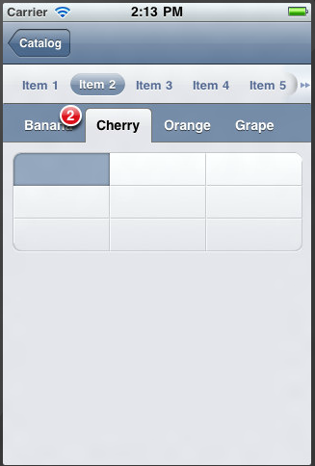
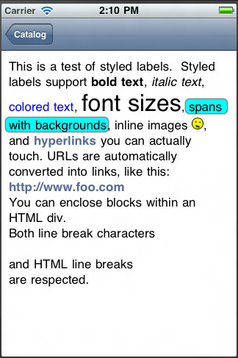
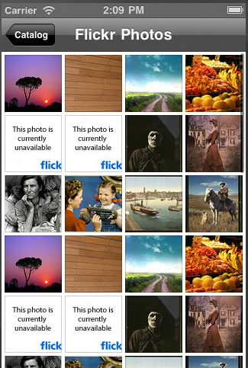
three20
http://three20.info/
Three20 provides powerful view controllers such as the Launcher, the popular Photo Browser, and internet-aware tables.
UI persistence, URL-based navigation.
Complete rewrite of three20: http://nimbuskit.info/

Slide 18
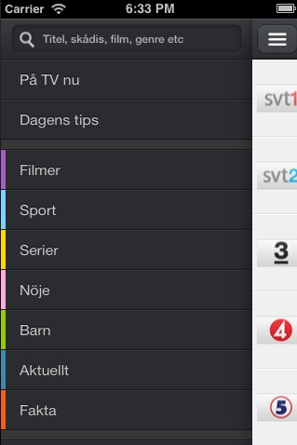
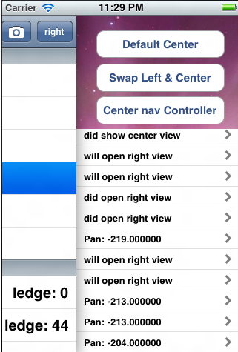
ViewDeck
https://github.com/Inferis/ViewDeck/
An implementation of the sliding functionality found in the Path 2.0 or Facebook iOS apps.
Left and right sideviews, switching views

Slide 19
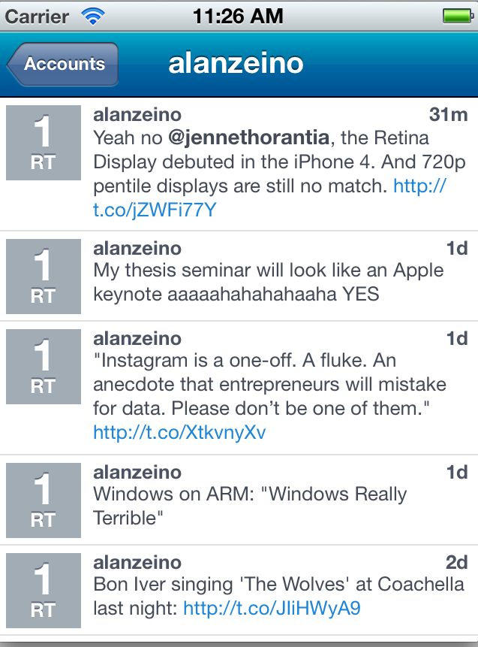
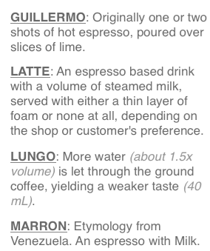
TTTAttributedLabel
https://github.com/mattt/TTTAttributedLabel/
A drop-in replacement for UILabel that supports NSAttributedStrings

Slide 20

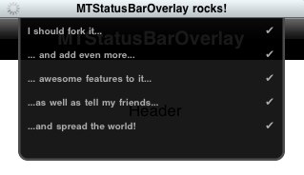

MTStatusBarOverlay
https://github.com/myell0w/MTStatusBarOverlay/
A custom iOS status bar overlay seen in Apps like Reeder, Evernote and Google Mobile App

Slide 21
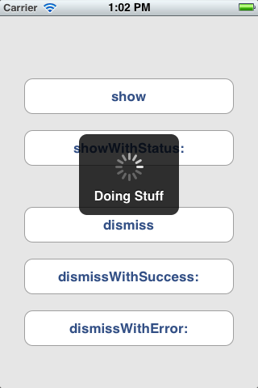
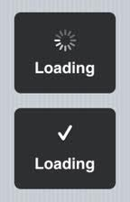
MBProgressHUD
https://github.com/jdg/MBProgressHUD
MBProgressHUD is an iOS drop-in class that displays a translucent HUD with an indicator and/or labels

Slide 22
Reader
https://github.com/vfr/Reader
PDF Reader/Viewer for iOS
iBooks-like document navigation.
Device rotation and all orientations.
Encrypted (password protected) PDFs.
PDF links (URI and go to page).
PDFs with rotated pages.
Supports large PDF files.

Slide 23
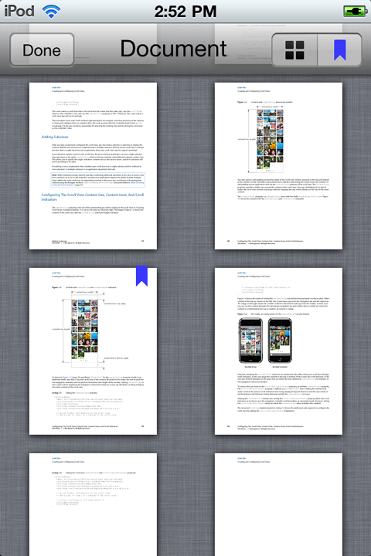
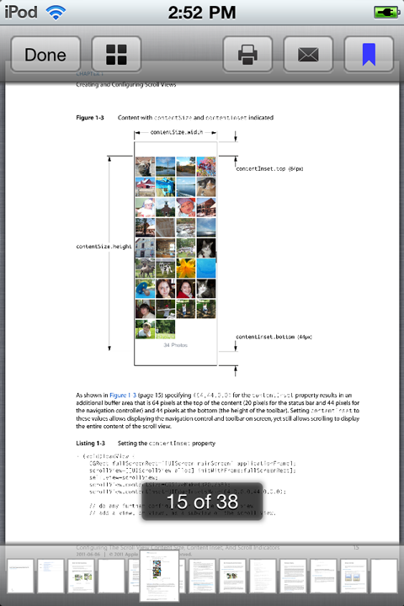
Reader

Slide 24
Data
JSON (TouchJSON, Json-framework, JSONKit, NextiveJson)
XML (TinyXML, TBXML, TouchXML, KissXML, GDataXML)
FMDB

Slide 25
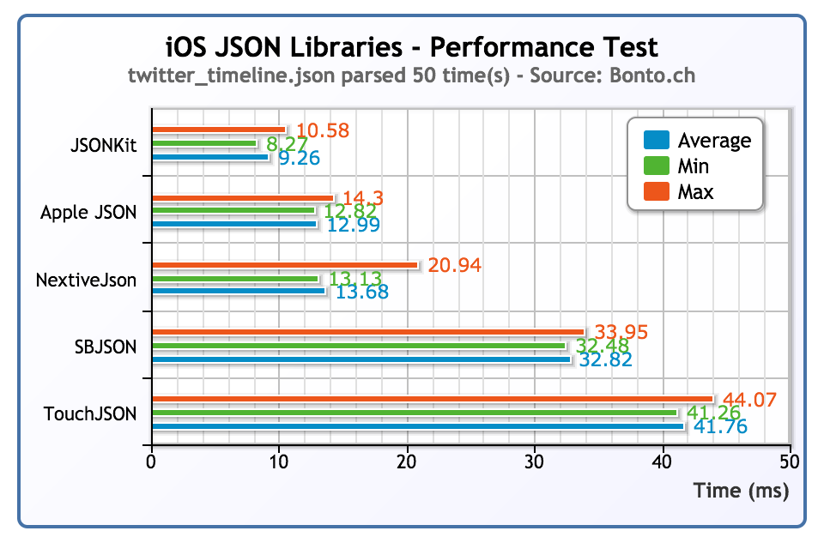
JSON
http://www.bonto.ch/blog/2011/12/08/json-libraries-for-ios-comparison-updated/

Slide 26
JSON
TouchJSON https://github.com/TouchCode/TouchJSON
SBJson (aka json-framework) https://github.com/stig/json-framework/
JSONKit https://github.com/johnezang/JSONKit
NextiveJson https://github.com/nextive/NextiveJson
NSJSONSerialization (iOS 5+)

Slide 27
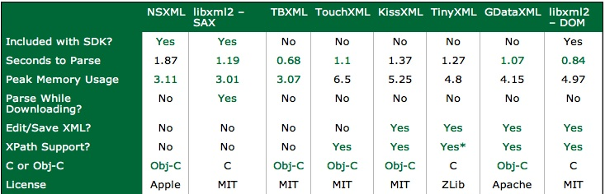
XML
http://www.raywenderlich.com/553/how-to-chose-the-best-xml-parser-for-your-iphone-project

Slide 28
XML
TBXML http://www.tbxml.co.uk/
TinyXML http://sourceforge.net/projects/tinyxml/
TouchXML https://github.com/TouchCode/TouchXML
KissXML https://github.com/robbiehanson/KissXML
GDataXML http://code.google.com/p/gdata-objectivec-client/

Slide 29
FMDB
https://github.com/ccgus/fmdb
A Cocoa / Objective-C wrapper around SQLite
Features:
Transactions
Data Sanitization
Making custom sqlite functions, based on blocks.

Slide 30
Various
DTFoundation
iOS Boilerplate
Underscore

Slide 31
DTFoundation
https://github.com/Cocoanetics/DTFoundation
Contained are several category methods
NSString+DTFormatNumbers - formatting Numbers
NSString+DTPaths - working with paths
NSURL+DTPrefLinks - getting direct-access URLs for preferences
NSURL+DTAppLinks - getting direct-access URLs for an app's app store and review page
UIImage+DTFoundation - helpful methods for drawing images
UIView+DTFoundation - helpful methods for working with views

Slide 32
DTFoundation
Other classes simplify working with specialized data
DTASN1Parser - a parser for ASN.1-encoded data (eg. Certificates)
DTAsyncFileDeleter - asynchronous non-blocking file/folder deletion
DTDownload - asynchronous file download with optional resume
DTHTMLParser - a libxml2-based HTML parser
DTVersion - parsing and comparing version numbers
DTZipArchive - uncompressing ZIP and GZ files

Slide 33
iOS Boilerplate
http://iosboilerplate.com/
It includes solid third-party libraries if needed to not reinvent the wheel
HTTP requests & images (AFNetworking, AFURLCache)
UITableView & cells (FastCells, Pull-down-to-refresh, Swipeable cells)
Built-in web browser
Maps & locations
Other things (JSONKit, SVProgressHUD, DictionaryHelper, StringHelper, DataHelper)

Slide 34
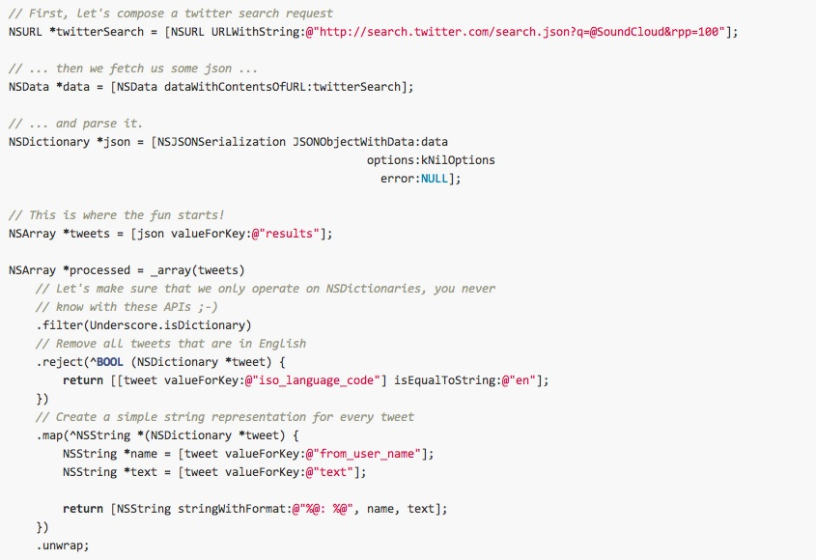
Underscore
https://github.com/robb/Underscore.m
A port of underscore.js to Objective-C

Slide 35
WHERE TO FIND OUT more
https://github.com/languages/Objective-C/most_watched
http://iosframeworks.com/frameworks
http://stackoverflow.com/questions/tagged/objective-c

Slide 36
Thanks!
Mikhail Merkulov
Email: mihail.merkulov@gmail.com
Twitter: @mikhailmerkulov

